Slide 1
Hotel Reservations Analysis using SQL
Project by Assem Yasser Elsherbiny

Slide 2
Table of contents
01
03
Introduction
insights
02
04
Dataset
Conclusion

Slide 3
01
Introduction

Slide 4
Introduction
in this project, we will engage with a hotel reservation dataset to derive insights that enhance guest experiences and inform strategic decisions. By analyzing data on guest preferences, booking patterns, and other critical factors, we will help improve the hotel's operations. we will using SQL to query the dataset, enabling us to answer specific questions and uncover meaningful trends.

Slide 5
02
Dataset

Slide 6
The Dataset includes
Booking_ID: A unique identifier for each hotel reservation.
no_of_adults: The number of adults in the reservation.
no_of_children: The number of children in the reservation.
no_of_weekend_nights: The number of nights in the reservation that fall on weekends.
no_of_week_nights: The number of nights in the reservation that fall on weekdays.
type_of_meal_plan: The meal plan chosen by the guests.
room_type_reserved: The type of room reserved by the guests.
lead_time: The number of days between booking and arrival.
arrival_date: The date of arrival.
market_segment_type: The market segment to which the reservation belongs.
avg_price_per_room: The average price per room in the reservation.
booking_status: The status of the booking.

Slide 7
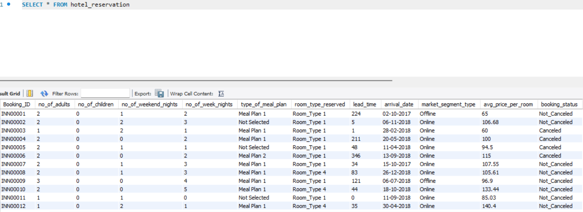
The Dataset includes

Slide 8
03
insights

Slide 9
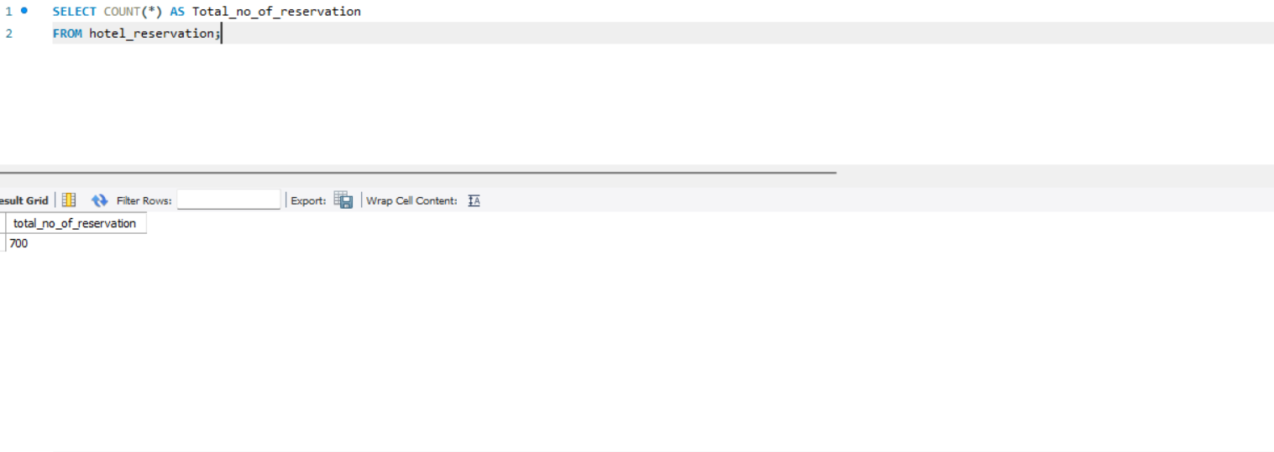
1.What is the total number of reservations in the dataset?

Slide 10
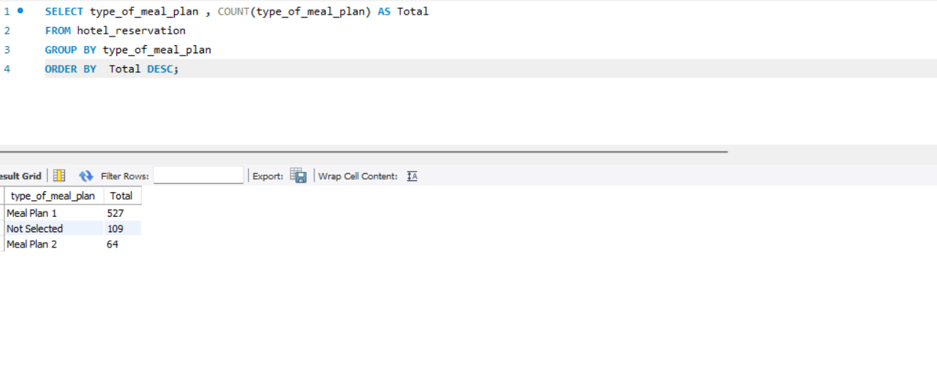
2. Which meal plan is the most popular among guests?

Slide 11
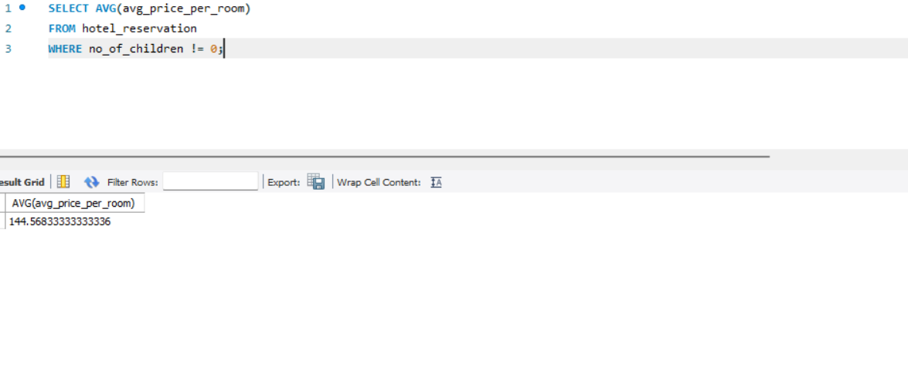
3. What is the average price per room for reservations involving children?

Slide 12
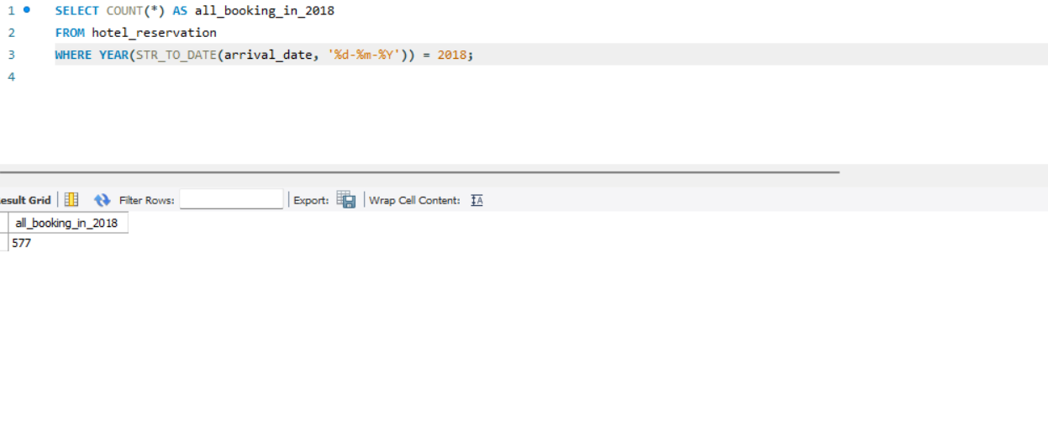
4. How many reservations were made for the year 2018?

Slide 13
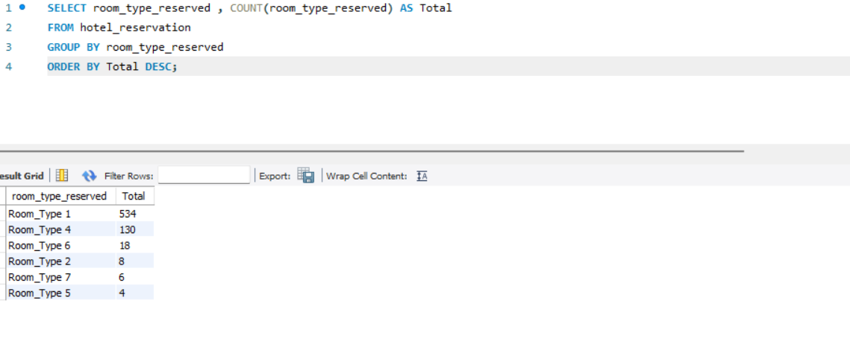
5. What is the most commonly booked room type?

Slide 14
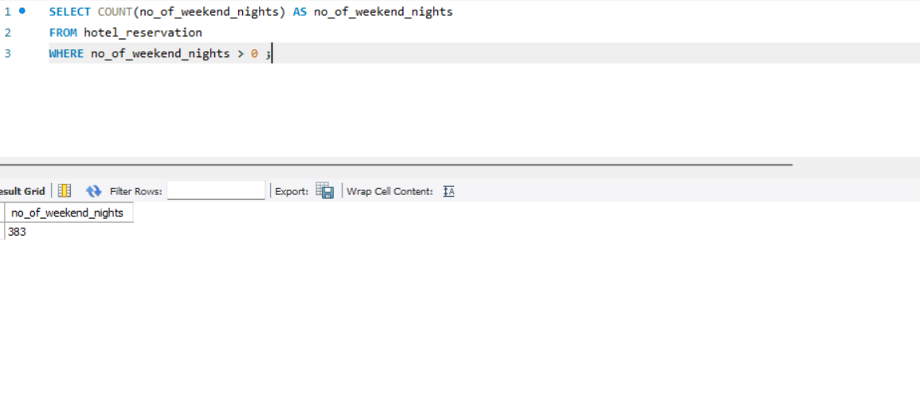
6. How many reservations fall on a weekend ?

Slide 15
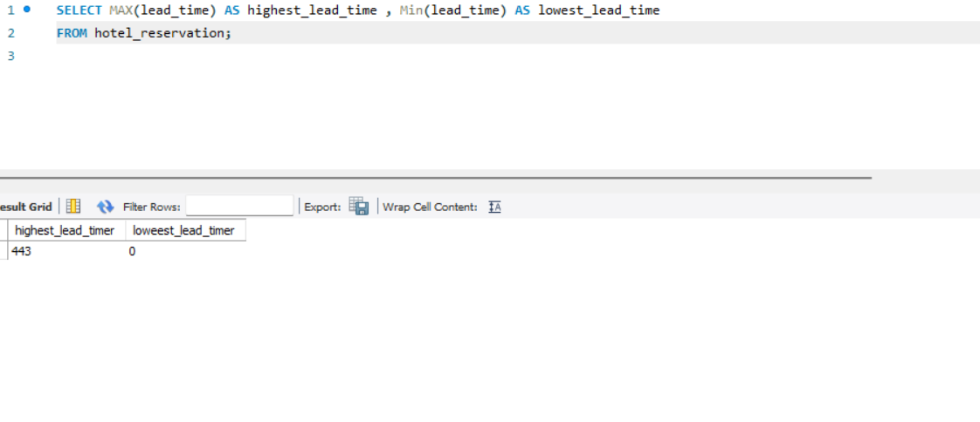
7. What is the highest and lowest lead time for reservations?

Slide 16
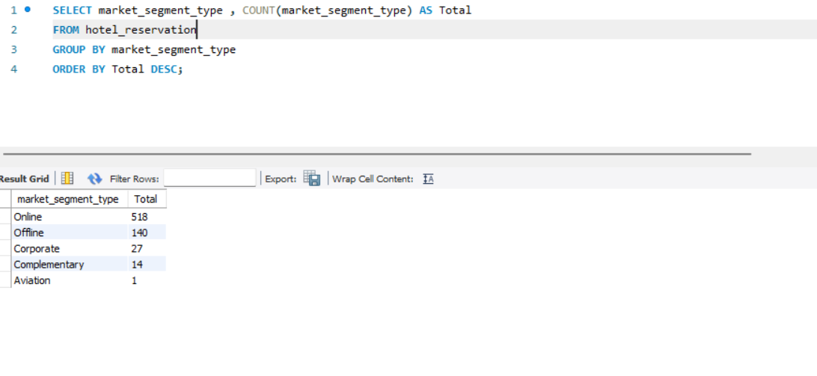
8. What is the most common market segment type for reservations?

Slide 17
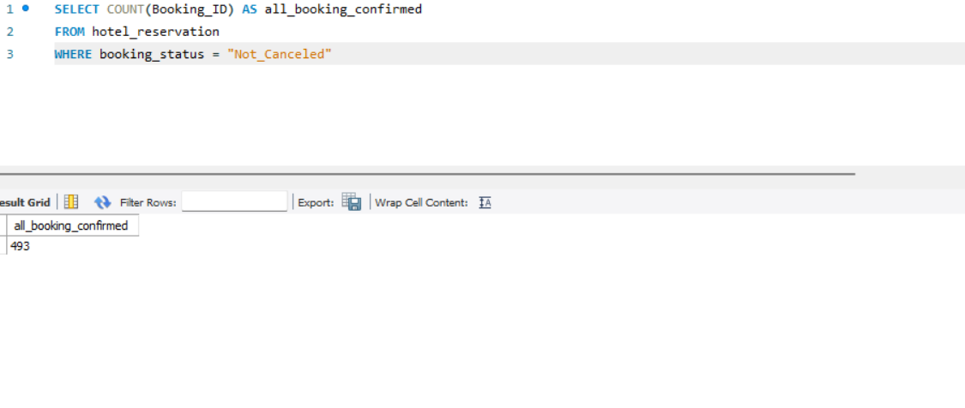
9. How many reservations have a booking status of "Confirmed"?

Slide 18
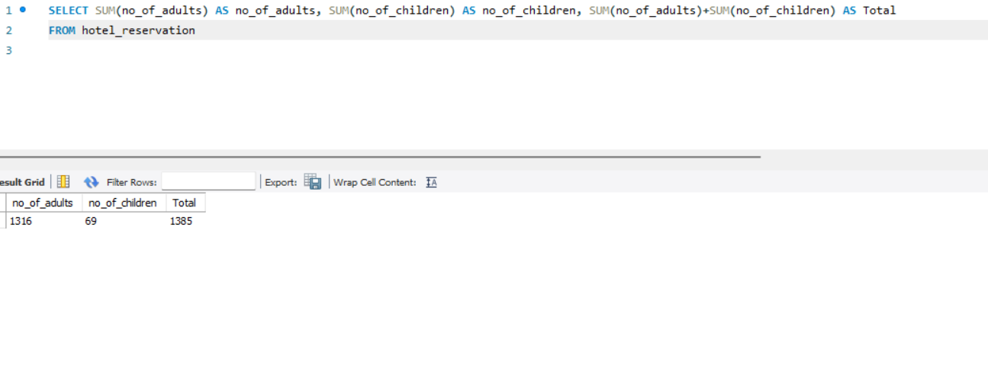
10. What is the total number of adults and children across all reservations?

Slide 19
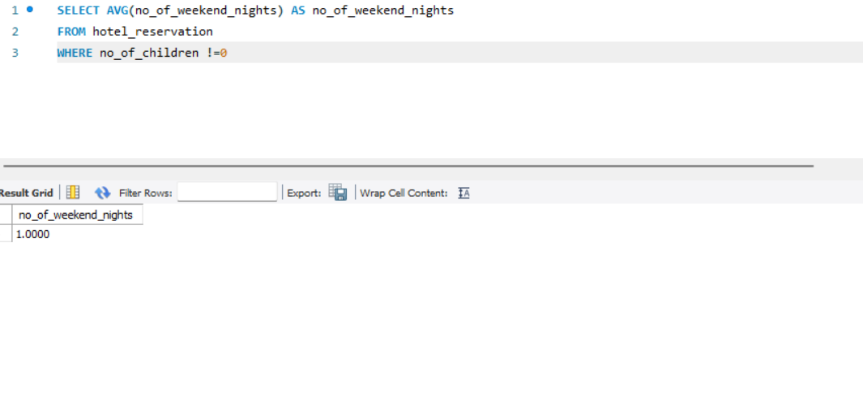
11. What is the average number of weekend nights for reservations involving children?

Slide 20
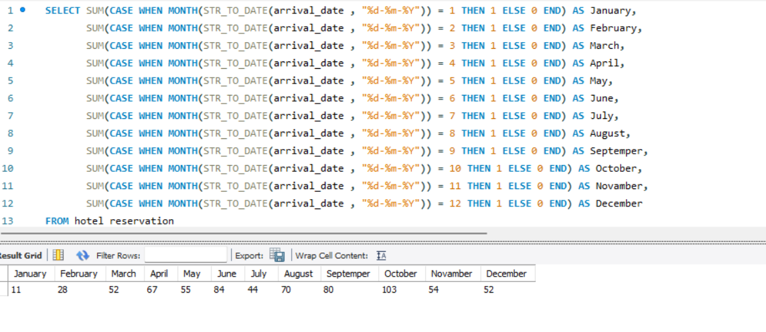
12. How many reservations were made in each month of the year?

Slide 21
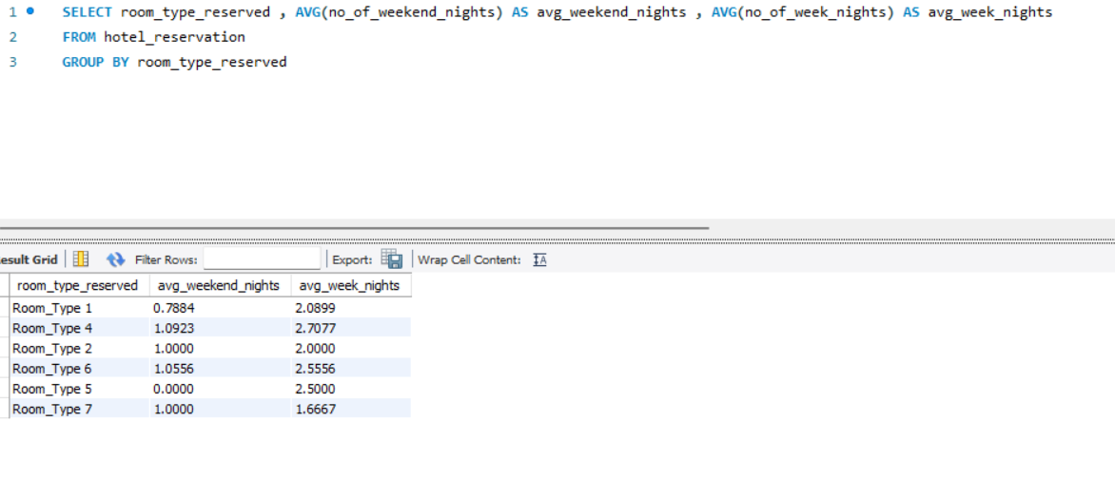
13. What is the average number of nights (both weekend and weekday) spent by guests for each room type?

Slide 22
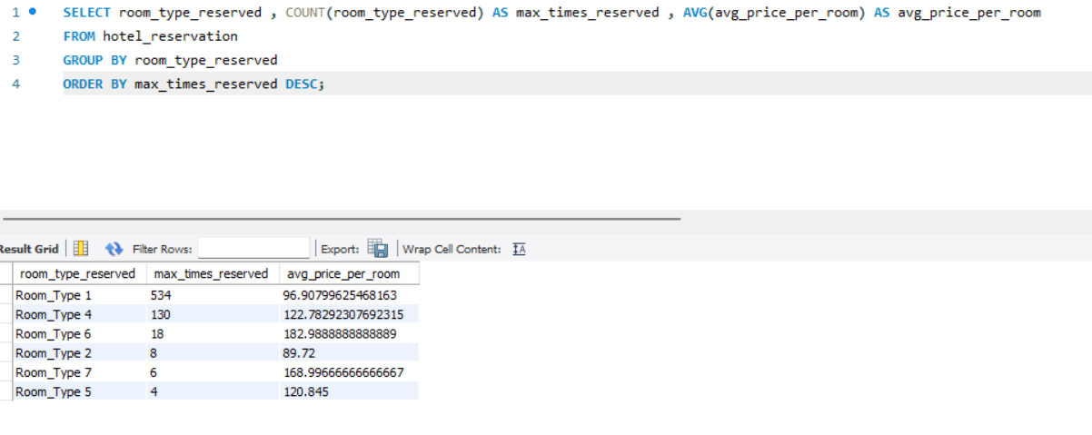
14. For reservations involving children, what is the most common room type, and what is the average price for that room type?

Slide 23
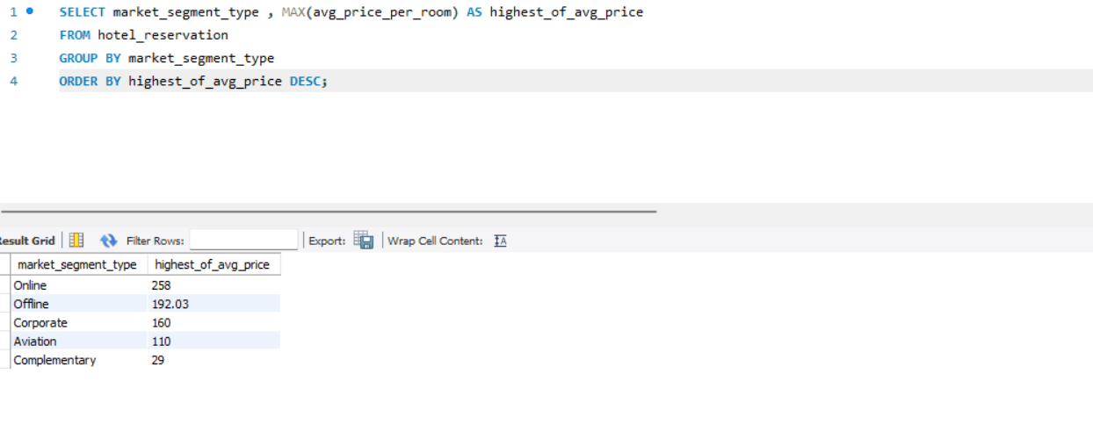
15. Find the market segment type that generates the highest average price per room ?

Slide 24
04
Conclusion

Slide 25
Conclusion
The total number of reservations is 700.
Total reservations on weekends are 383.
The hotel confirmed 493 bookings, meaning approximately 70% were confirmed reservations and 30% of customers canceled their reservations.
The highest booking reservation method is ONLINE, with approximately 73% of customers booking hotel rooms online.
The total number of children is 69, while the total number of adults is 1316.

